Slide 1

Video-Language Pre-training based on Transformer Models
Submitted by,
Raghava Devaraje Urs 015135653

Slide 2

Introduction
Transfer-based training for natural language processing and computer vision.
In the pre-training step of machine learning, the model is trained using a large amount of data referred to as training data.
Once this is complete, it is fine-tuned on a smaller dataset. This step eventually helps in the betterment of the downstream tasks.
Transformer networks have become popular in the field of Deep Learning by providing precedence in performance. Having a smaller model bias and network structure easy to deepen makes the transformer ideal for training and finetuning.
Making transformers superior compared to Multi-Layer Perceptrons (MLP), Convolutional Neural Networks (CNNs), and Recurrent Neural Networks (RNNs).

Slide 3
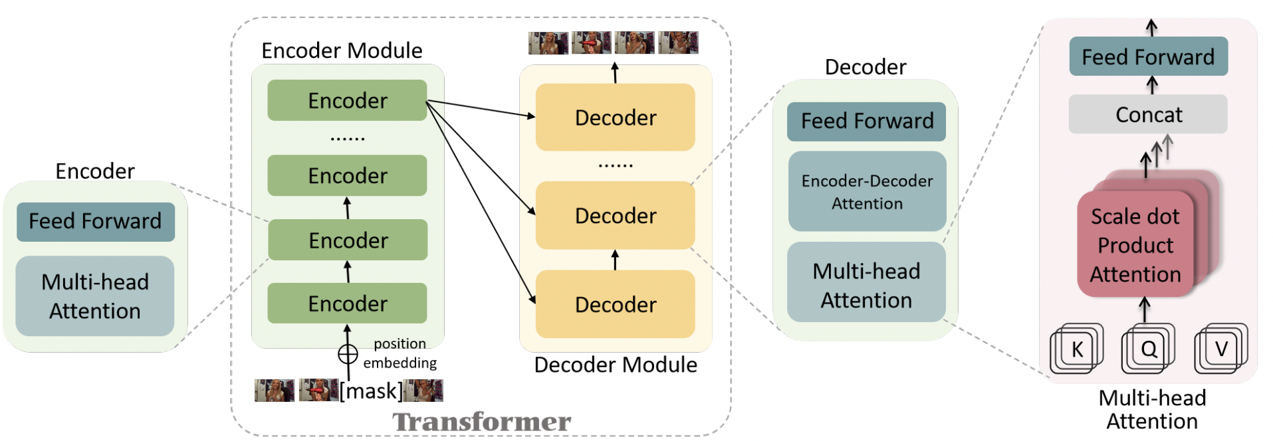
Transformer architecture

Slide 4
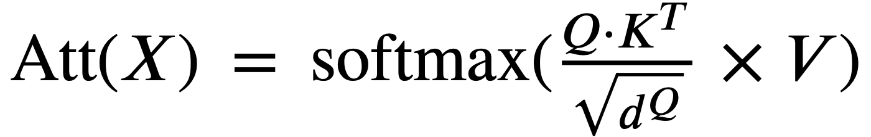
Self-Attention

Slide 5
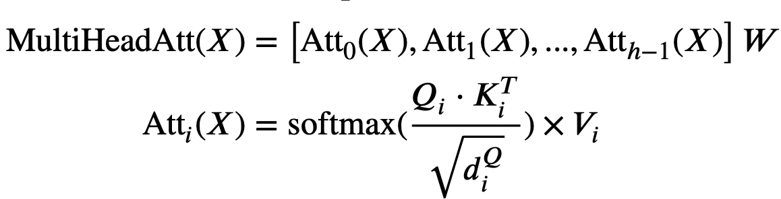
Multi-Head Attention

Slide 6
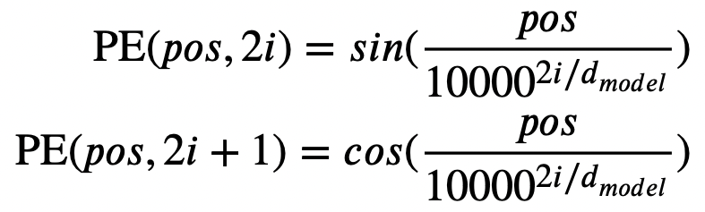
Position Encoding

Slide 7
Pre-training and fine-tuning
Proxy tasks
Video-Language Downstream Tasks

Slide 8
Proxy tasks
Completion tasks
Matching tasks
Ordering tasks

Slide 9

Completion tasks
Masked Language Modelling (MLM)
Masked Frame Modelling
Masked Token Modeling
Masked Modal Modeling
Language Reconstruction
Video Language Matching
Sentence Ordering Modeling
Frame Ordering Modeling

Slide 10
Video Language Downstream Tasks
Text-based Video Retrieval
Action Recognition
Action Segmentation
Action Step Localization
Video Question Answering
Video Captioning

Slide 11
Video-Language Datasets
Label Based
Caption Based

Slide 12
Video-language Transformer Models
Single-Stream Transformers
VideoBERT
HERO - Hierarchical Encoder for Omni representation
CLipBERT
DeCEMBERT - Dense Captions and Entropy Minimization
VLM - Video Language Model
VATT - Video Audi Text Transformer
VATT - Video Audi Text Transformer

Slide 13
Video-language Transformer Models
Multi-Stream Transformers
CBT
ActBERT
Univl

Slide 14
Summary and Conclusion
Transformer block perspective
Word and Video embedding
Model training objectives
Model evaluation

